Slide 1

Microbiome: current and future status
Best practices – on experimental design and the cautionary tales of false signals
Standard and custom designed workflows – context and resolution dependent
Statistical rigor
Visualization and functional analysis
New directions of AI
New consumer markets
New conservation ecology
New clinical applications

Slide 2
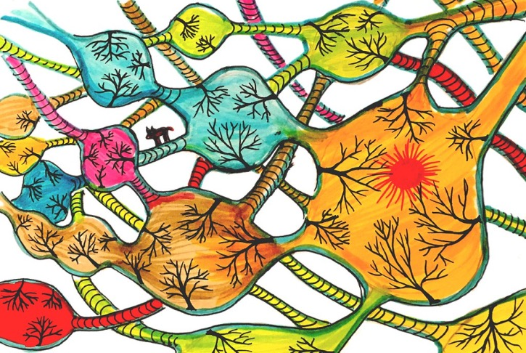
Host-microbiome interactions in global health
Oberstaller et al, F1000research, 2020
Collaborative coding integrating data sciences, public health, & humanities research

Slide 3
Redefine the boundary of a human by internal and external microbiota

Slide 5
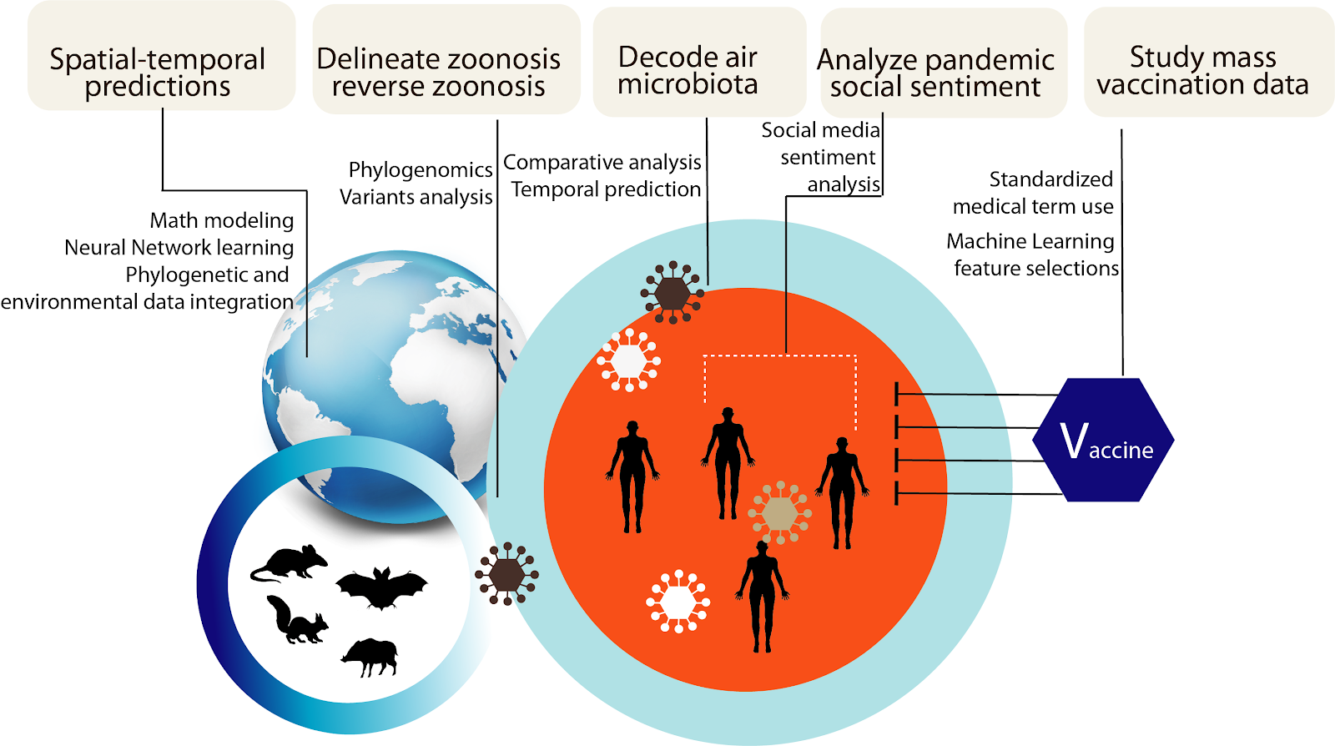
Collaborative coding against pandemics

Slide 6
Topics for coding against pandemics
Viral discovery – zoonotic virus has a large reservoir, that might have been deposited in the various database
Host genetics – efficient interrogation of human variants for disease outcomes
Respiratory microbiome – integrate and explore air-borne microbiome diversities
Microbe interactions – explore the relationship between human microbiome and airway diseases
Sewage / urban air microbiome mining – mining and searching for potential pathogens.

Slide 7
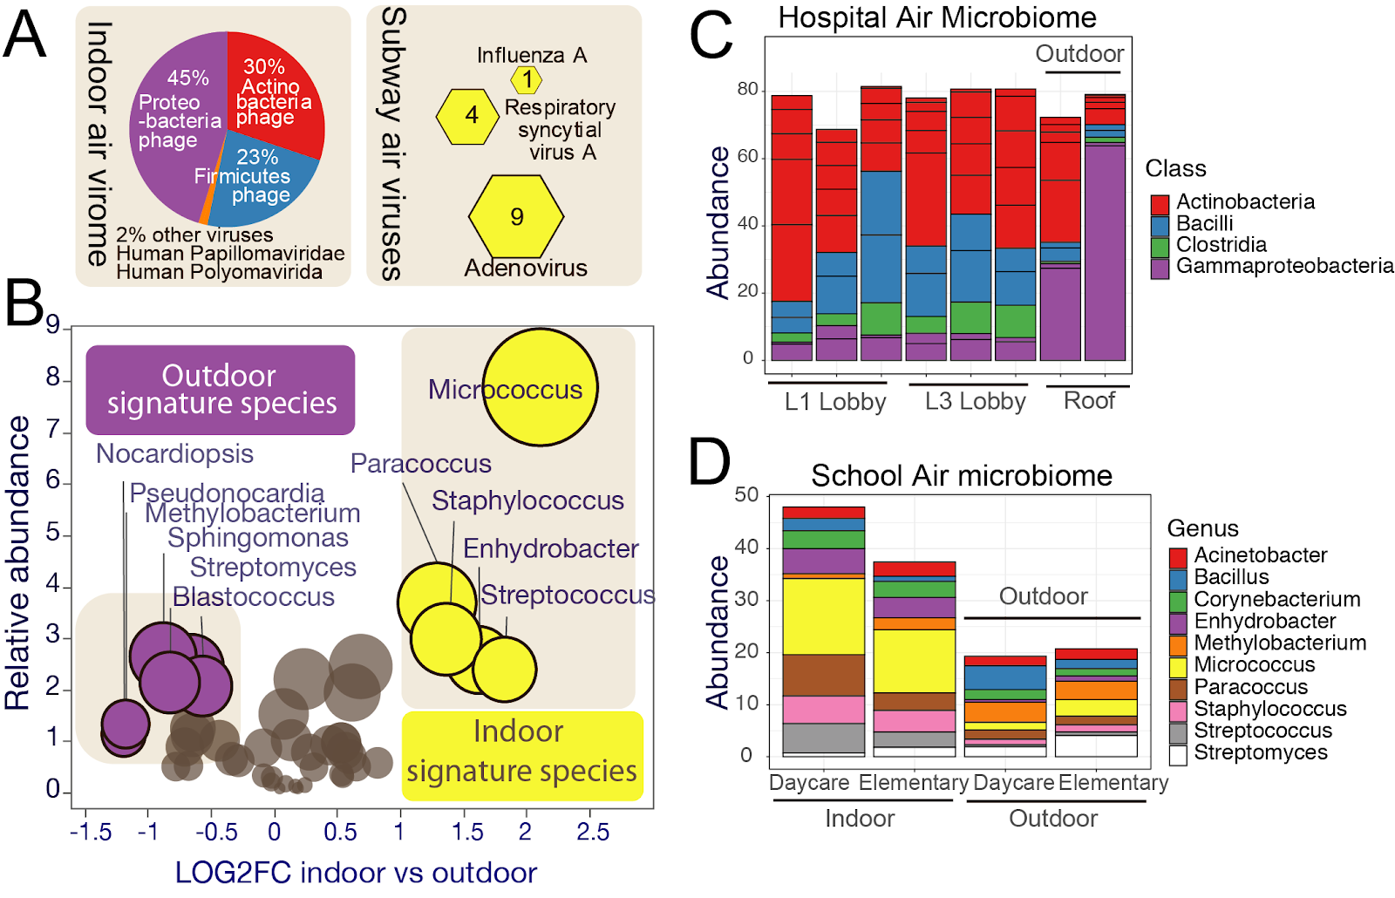
Air microbiota – microbiome mycobiome virome

Slide 8
Microbiome projects
COPH(funded)– Single cell C. difficile microbiome project
NSF(submitted) – invasion ecology and gut microbiome adaptations.
NSF (to be submitted) – Tracking ancient global pandemics with microbiomes
NSF (in prep) – Decoding neural system and marine microbiota interactions
NIH (to resubmit) – Modulating neuro-degenerative diseases from gut microbiomes
USF( to resubmit) – Engineering Microbiome-on-a-chip
USF(to resubmit) – Capturing and decoding breath microbiomes
NSF(funded on other things, but spin off) – Evolution of immunity and gut microbiota

Slide 9
AI BIO – powered by AI
Microbe interactions in neuron genesis
Microbiome in neural plasticity
Microbiome in human diet evolution
Microbiome in animal immunity evolution
Deep learning on interpretability
Neural network of two-way interactions
Autoencoder variations of plasticity
Knowledge representations
Deep learning classifiers

